Slide 1

Healthcare Laboratory Report Management Using File Pointer Optimization and Exception Handling Compared with Sequential File Processing for Enhanced Fault Tolerance
DSA0114-OBJECT ORIENTED PROGRAMMING WITH C++
Under the supervision of :
Dr. Saroo Raj R B
BY:
NIVETHA S (192511269)
MOHANALAKSHMI S(192511274)
LAKSHMI SHRUTHIKSHA A (192511385)

Slide 2



INTRODUCTION
Healthcare Laboratory Report Management System is developed using C++.
Manages patient details and laboratory reports efficiently.
Uses file handling for permanent data storage.
Implements file pointer optimization for faster record access.
Handles runtime errors using exception handling.
Improves fault tolerance and data reliability.
Provides better performance than sequential file processing.

Slide 3

PROBLEM STATEMENT
Manual laboratory record management is slow and inefficient.
Sequential file processing increases retrieval time.
Updating records requires scanning the complete file.
File corruption may lead to data loss.
Invalid user inputs may cause program failure.
Lack of proper error handling reduces reliability.
An optimized and secure solution is required.
*
4

Slide 4

OBJECTIVE
Automate laboratory report management.
Maintain patient and laboratory records efficiently.
Optimize file operations using file pointers.
Compare optimized and sequential processing methods.
Improve execution speed and performance.
Handle exceptions to prevent application crashes.
Ensure secure and fault-tolerant data management.
3/20/2025

Slide 5
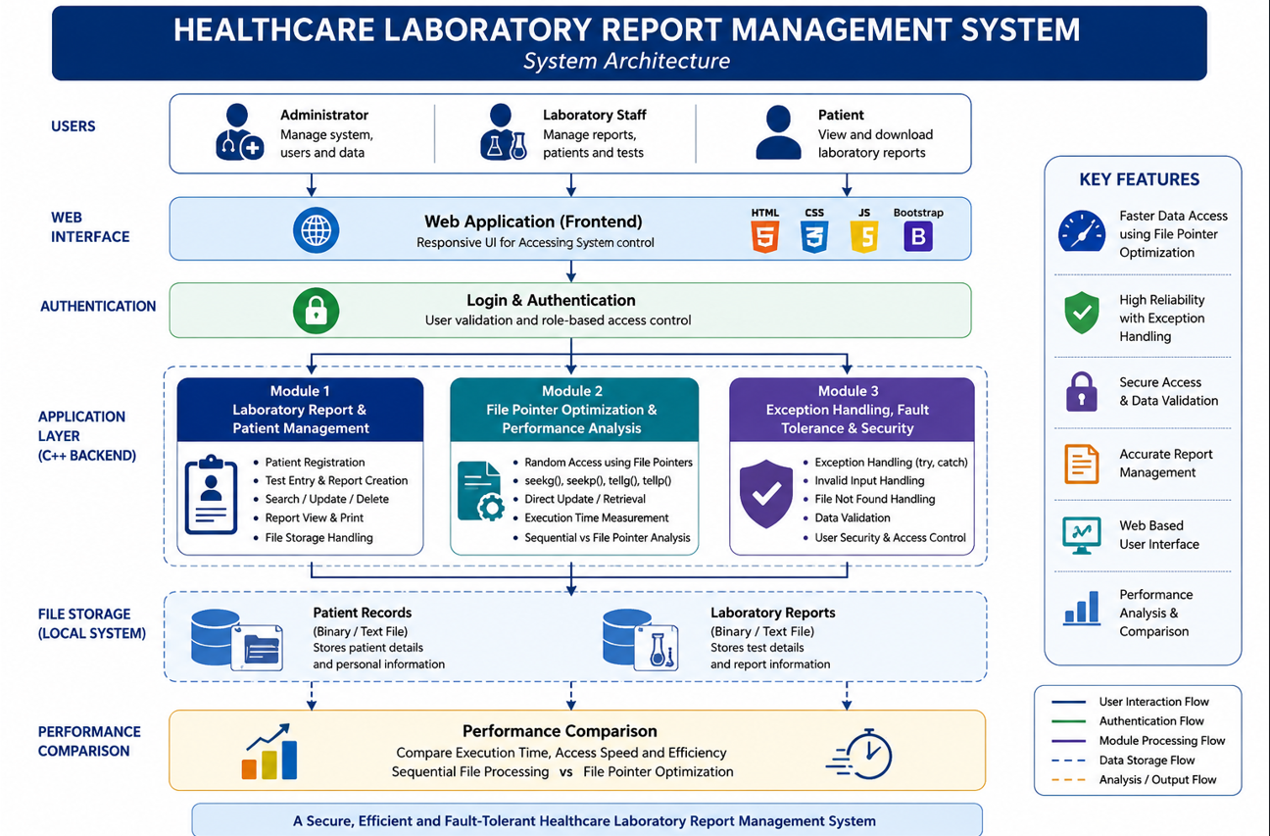
SYSTEM ARCHITECTURE

Slide 6
MODULE 1 – Advanced Laboratory Report & Patient Management
OVERVIEW
Provides a centralized platform for managing patient and laboratory information.
Maintains patient profiles, laboratory test details, diagnoses, and report history.
Supports report creation, modification, search, and deletion through an interactive interface.
Stores all records securely using C++ file handling for efficient data management.
Integrates with a user-friendly web page for easy access by laboratory staff and administrators.
Reduces manual documentation, improves record accuracy, and enhances workflow efficiency.
Ensures organized storage and quick retrieval of laboratory reports.
5

Slide 7
PROCESS
Register patient details and assign a unique Patient ID.
Record laboratory test requests and corresponding test results.
Generate and update laboratory reports based on test outcomes.
Search patient records using Patient ID or patient name.
Store and retrieve records using structured file management.
Display reports through the web interface for quick access.
Maintain complete patient report history for future reference.

Slide 8
MODULE 2 – FILE POINTER OPTIMIZATION & PERFORMANCE ANALYSIS
OVERVIEW
Implements optimized file handling using file pointers for direct record access.
Eliminates unnecessary sequential file traversal during search and update operations.
Enhances the speed and efficiency of report retrieval and modification.
Performs comparative analysis between optimized file access and sequential file processing.
Measures execution time, file access time, and overall system performance.
Supports efficient handling of large laboratory datasets with minimal processing delay.
Improves scalability and responsiveness of the application.

Slide 9
PROCESS
Store patient records in structured data files.
Access specific records directly using file pointer functions.
Update and modify records without scanning the complete file.
Execute sequential file processing for comparison.
Measure execution time and memory usage for both methods.
Generate performance statistics and comparison reports.
Display performance results through the web dashboard using charts and tables.

Slide 10
MODULE 3 – EXCEPTION HANDLING, FAULT TOLERANCE & SECURITY
OVERVIEW
Implements exception handling to ensure uninterrupted system execution.
Detects and handles runtime, file access, and input validation errors.
Prevents application crashes caused by invalid operations or corrupted files.
Provides secure access through user authentication and role-based login.
Maintains data integrity during report creation, modification, and retrieval.
Improves system reliability with fault-tolerant error recovery mechanisms.
Protects sensitive patient and laboratory information from unauthorized access.
*

Slide 11
PROCESS
Validate all user inputs before processing requests.
Authenticate users before granting access to the system.
Detect missing, corrupted, or inaccessible data files.
Handle runtime exceptions using try-catch mechanisms.
Display meaningful error messages and recovery options.
Record system errors and user activities for monitoring.
Ensure continuous operation without affecting existing laboratory records.
*

Slide 12
FUTURE SCOPE
A web-based interface can improve accessibility and user experience.
Cloud storage can provide secure and centralized report management.
Role-based login can enhance data privacy and security.
Database integration can support large-scale record management.
QR code verification can simplify report authentication.
Analytics dashboards can assist in monitoring laboratory performance.
*

Slide 13
CONCLUSION
File pointer optimization enables faster and more efficient file operations.
Exception handling improves system reliability and fault tolerance.
The web interface enhances accessibility and user convenience.
The system ensures secure, organized, and accurate healthcare data management.
Overall, it offers a reliable and efficient alternative to conventional sequential file processing.
The proposed system simplifies laboratory report and patient record management.
*

Slide 14
REFERENCES
Alenazi, S. M., & Bugis, B. A. (2023). The role of laboratory information system in improving the delivery of laboratory services: A recent systematic review. Combinatorial Chemistry & High Throughput Screening, 26(8), 1451–1460. https://doi.org/10.2174/1386207325666220914112713
Edayan, J. M., Gallemit, A. J., Sacala, N. E., Palmer, X.-L., Potter, L., Rarugal, J., & Velasco, L. C. (2024). Integration technologies in laboratory information systems: A systematic review. Informatics in Medicine Unlocked, 50, 101566. https://doi.org/10.1016/j.imu.2024.101566
Edgerton, M. E., & Englund, A. (2024). Analysis of laboratory data transmission between two healthcare institutions using a widely used point-to-point health information exchange platform: A case report. JAMIA Open, 7(2), ooae032. https://doi.org/10.1093/jamiaopen/ooae032
Fu, Q., Lai, J., Zhong, T., et al. (2023). Design and implementation of Clinical LIS360 laboratory management system based on AI technology. International Journal of Computational Intelligence Systems, 16, 33. https://doi.org/10.1007/s44196-023-00207-8
*

Slide 15
THANK YOU
3/20/2025

